Slide 1
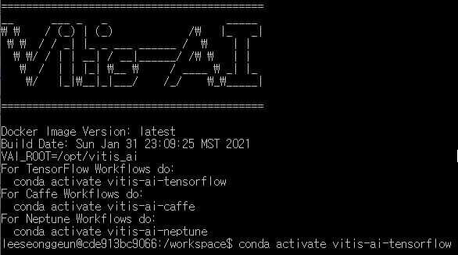
ZSK Tutorial
➔ conda activate vitis-ai-tensorflow

Slide 2
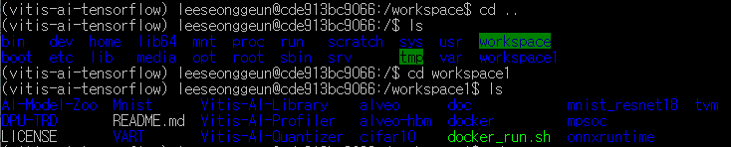
ZSK Tutorial
cd ..
cd workspace1

Slide 3
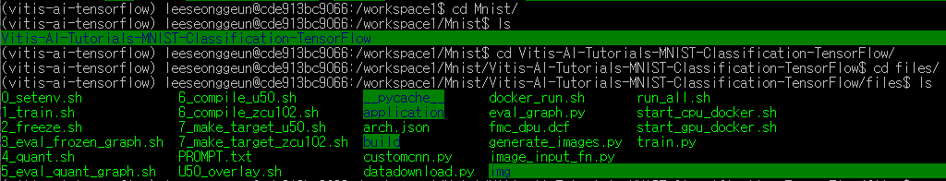
ZSK Tutorial
cd Mnist
cd Vitis-Ai-Tutorials-Mnist-Classification-TensorFlow
cd files

Slide 4
ZSK Tutorial
source ./0_setenv.sh

Slide 5
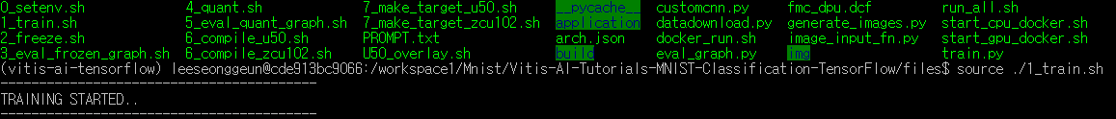
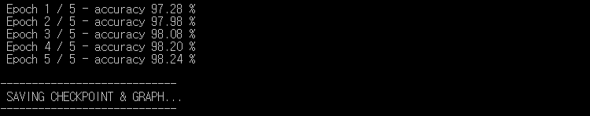
ZSK Tutorial
source ./1_train.sh

Slide 6

ZSK Tutorial
source ./2_freeze.sh

Slide 7

ZSK Tutorial
source ./3_eval_frozen_graph.sh

Slide 8
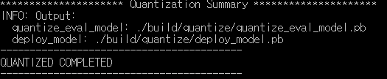
ZSK Tutorial
source ./4_quant.sh

Slide 9

ZSK Tutorial
source ./5_eval_quant_graph.sh

Slide 10

ZSK Tutorial
source ./6_compile_zcu102.sh

Slide 11
ZSK Tutorial
cd build
cd compile_zcu102

Slide 12
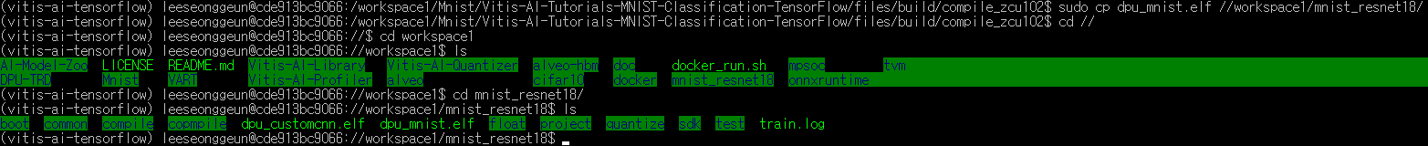
ZSK Tutorial
sudo cp dpu_mnist.elf //workspace1/mnist_resnet18
cd //
cd workspace1
cd mnist_resnet18

Slide 13
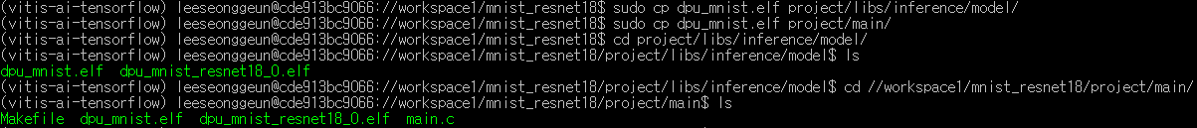
ZSK Tutorial
sudo cp dpu_mnist.elf project/libs/inference/model/
sudo cp dpu_mnist.elf project/main/
cd project/libs/inference/model/
cd //workspace1/mnist_resnet18/project/main/

Slide 14
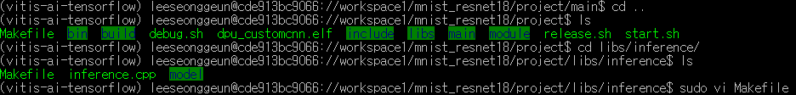
ZSK Tutorial
sudo vi Makefile
cd ..
cd libs/inference/
sudo vi Makefile

Slide 15
ZSK Tutorial
cd //workspace1/mnist_resnet18
cd sdk/
./sdk.sh
설치경로 물어보면 ./sdk/

Slide 16
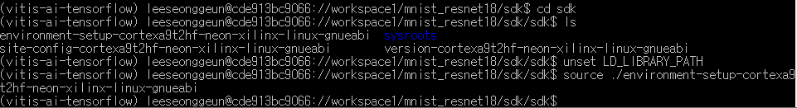
ZSK Tutorial
cd sdk
unset LD_LIBRARY_PATH
source ./environment ~~~

Slide 17
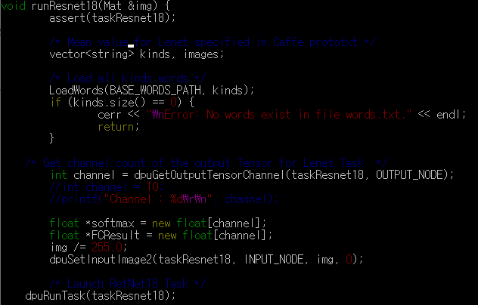
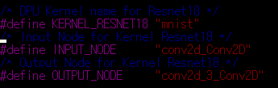
ZSK Tutorial
cd .. X 2
Cd project/libs/inference
Sudo vi inference.cpp
KERNEL_RESNET18, INPUT_NODE, OUTPUT_NODE 3가지 수정

Slide 18
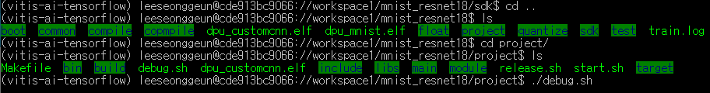
ZSK Tutorial
cd .. X 2
cd project/
./debug.sh

Slide 19
ZSK Tutorial
cd tartget/
cd ..
sudo cp –r target/* //workspace

Slide 20
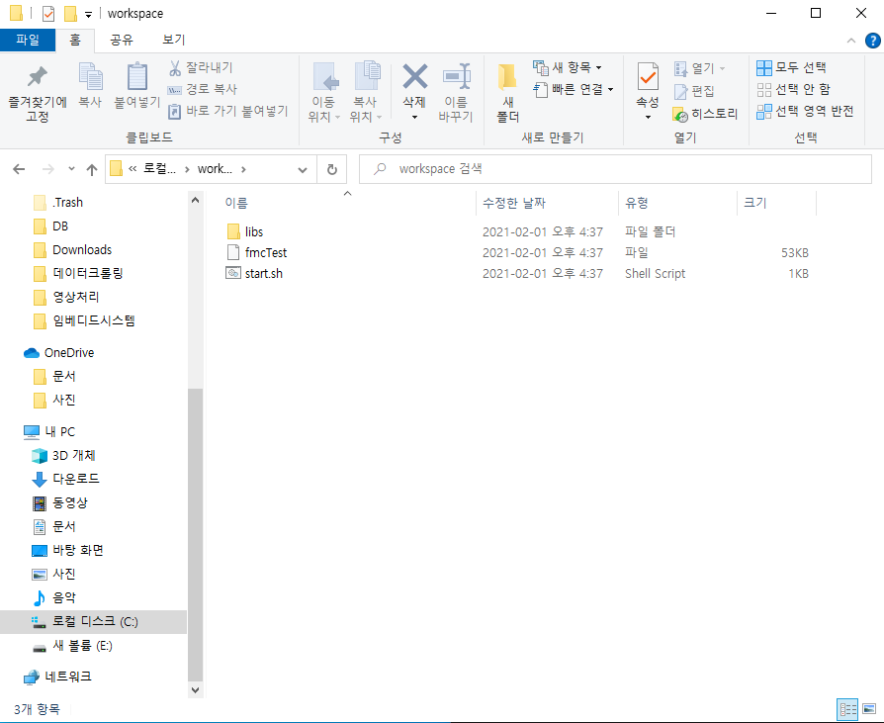
ZSK Tutorial
Window 로컬 디스크(C:\workspace) 에서 복사한 실행파일을 확인할 수 있다.

